Slide 1
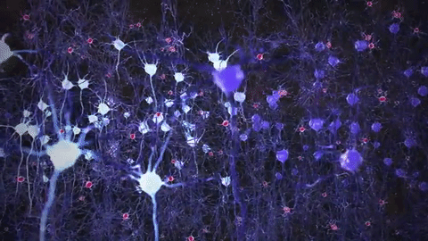
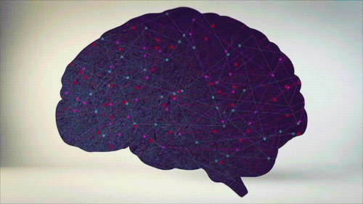

Predict Neural Activity in visual discrimination task
By: Anupriya Gupta, Ali Mohammadnezhad,Tahereh Taleei, Sedighe Mirbolouk, Samira Rezaei
Group: Headway
Pod: Gallirallus_mbube_B
TAs: Furkan Özçelik, Yousef Ghanbari
Project Mentor: Andrea Ivan Costantino
Notes:
Hello all!

Slide 2
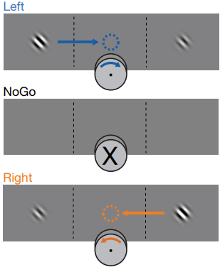
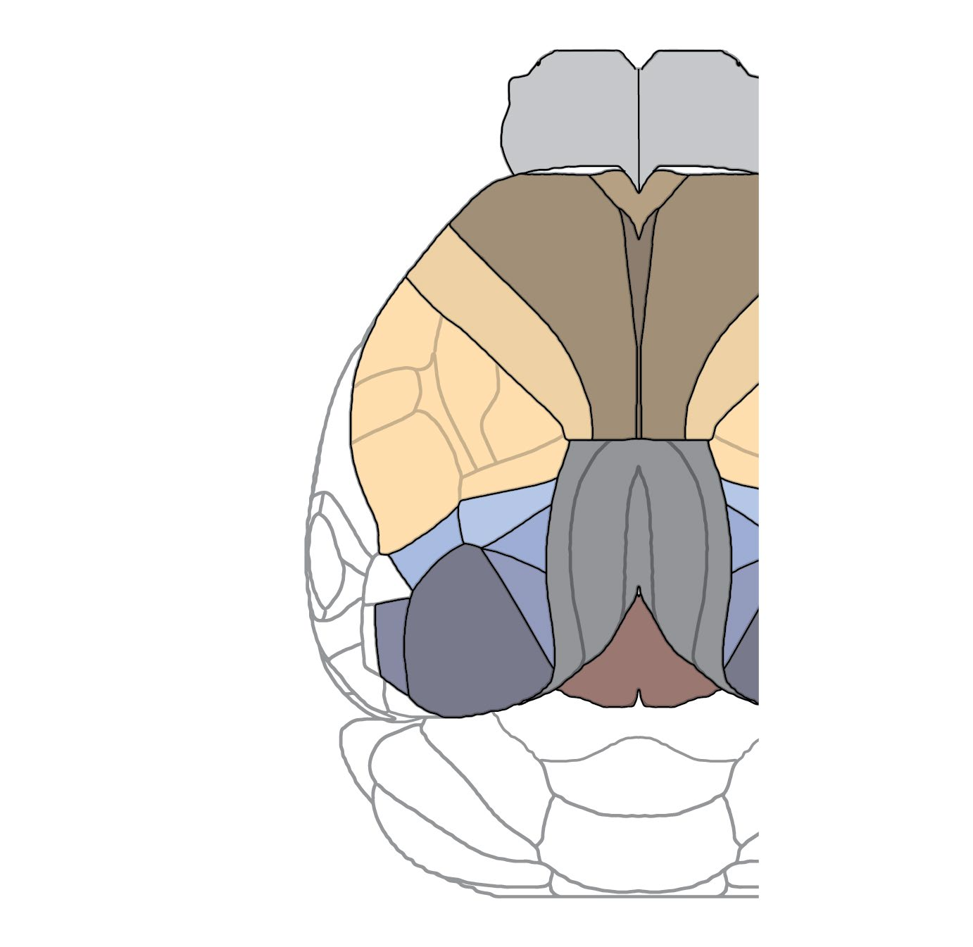
Background
Can we use the neural activity from one brain region to predict activity in another?
is it possible to decipher low-dimensional dynamics to make such predictions during specific tasks?
Steinmetz dataset, which comprises 39 Neuropixels recordings of 400-700 neurons from 42 regions of mice's brains during a visual behavior task
MOs
MOp
ROIs:
VISp
Literature:
Steinmetz, N. A., Zatka-Haas, P., Carandini, M., & Harris, K. D. (2019). Distributed coding of choice, action and engagement across the mouse brain. Nature, 576(7786), 266-273.
Froudarakis, E., Fahey, P. G., Reimer, J., Smirnakis, S. M., Tehovnik, E. J., & Tolias, A. S. (2019). The visual cortex in context. Annual review of vision science, 5, 317-339.

Slide 3
Hypothesis
Vision, choice, action and behavioural engagement arise from neuronal activity that may be distributed across brain regions. It is assumed that the activity of a group of neurons through the activity of other neurons is identified due to the presence of connectivity in the brain during a visual discrimination task.
The prediction of activity of a group of neurons from one region from the activity of all neurons in another region. For this aim, it is assumed that the activity of neurons in the secondary motor cortex (MOs) based on the activity of a group of neurons in the primary visual cortex (VISp) during a visual discrimination task is predictable.

Slide 4
Methods
Exploration of Steinmetz Dataset
1 numpy array with 39 values, one for each session/experiment
Each session has different dictionaries having data such as spks, brain_area, mouse_name, responses, and so on.
Spks data is a 3D array with Neurons, Trials & Timebins
Choosing two brain areas
Area 1: primary visual cortex (VISp) and Area 2: secondary motor cortex (MOs)
Why: Because these two brain areas are essential for this experiment and are interrelated.
Creating a 1D RNN Model
Hyperparameters: latent components, learning rate, dropout, training iterations
Training the model
Input data shape: (250, 150, 178) Output data shape: (250, 150, 113)
Validation data shape: (250, 32, 178) Output data shape: (250, 32, 113)
Loss function: Poisson Loss function
Testing the model
Input data shape: (250, 32, 178) Output data shape: (250, 32, 113)

Slide 5
Results
ncomp = 10 , lr = 0.01, niter = 500
Training cost
iteration 0, cost 0.2023 iteration 100, cost 0.1152 iteration 200, cost 0.1138 iteration 300, cost 0.1130 iteration 400, cost 0.1124
test cost 0.1274
ncomp= 30 lr = 0.01, niter = 500
Training Cost:
iteration 0, cost 0.1718
iteration 100, cost 0.1125
iteration 200, cost 0.1111
iteration 300, cost 0.1103
iteration 400, cost 0.1099
test cost 0.1331
Not much benefit on increasing latent components
ncomp = 10 , lr = 0.005, niter = 500
Training Cost:
iteration 0, cost 0.2050
iteration 100, cost 0.1166
iteration 200, cost 0.1150
iteration 300, cost 0.1142
iteration 400, cost 0.1138
test cost 0.1278
Not much benefit on reducing the learning rate

Slide 6
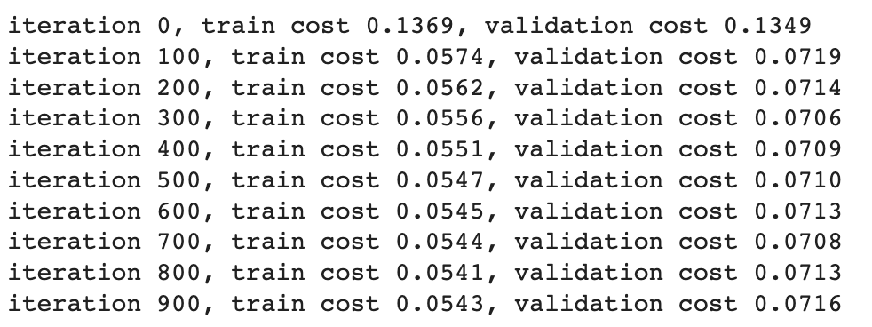
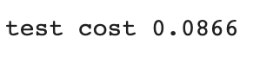
Results
ncomp = 10 , lr = 0.005, niter = 1000

Slide 7
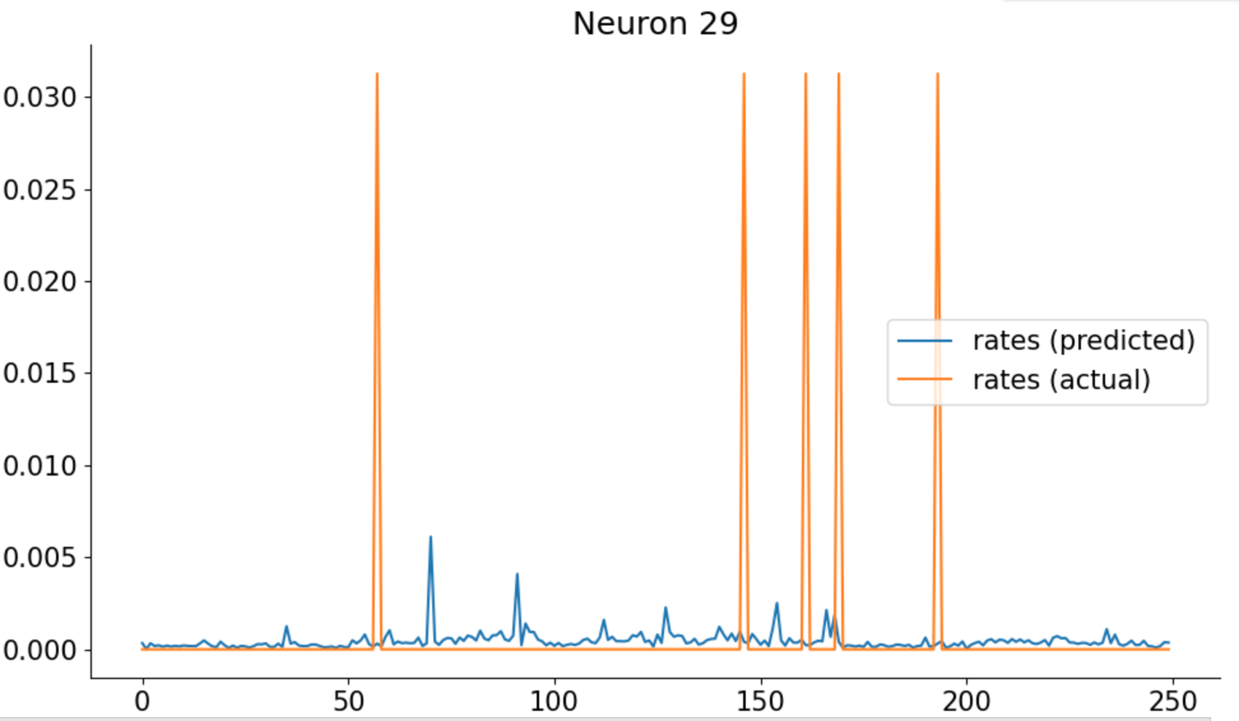
Result

Slide 8
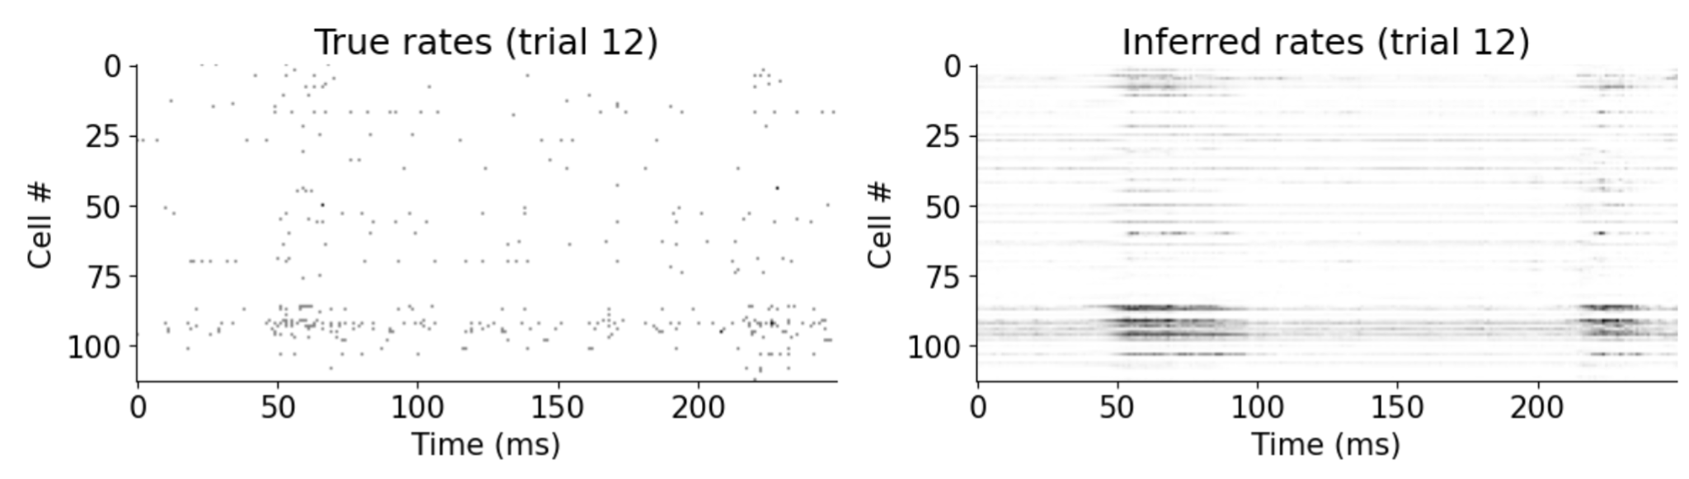
Result

Slide 9
Observation and Inference
We can say that the model was able to predict activity in one area (MOs) given activity in another area (VISp), because when run on the test set, the Poisson cost function was less.
We printed predicted and actual spiking values of test dataset but the results were not good.
We believe this is due to less data we used in training. Alternatively, it could be due to the training model being a simple 1D RNN model.

Slide 10
Conclusion and future scope
How Information flows from VISp to MOs:
primary visual cortex → dorsal stream → secondary motor cortex
Connectivity analysis
Using all of mice data
Data augmentation

Slide 11
Thank you

Slide 12
Annexure: Model

Slide 13
iteration 0, train cost 0.1440, test cost 0.1429 iteration 100, train cost 0.0823, test cost 0.0823 iteration 200, train cost 0.0676, test cost 0.0679 iteration 300, train cost 0.0657, test cost 0.0660 iteration 400, train cost 0.0648, test cost 0.0653 iteration 500, train cost 0.0643, test cost 0.0648 iteration 600, train cost 0.0639, test cost 0.0645 iteration 700, train cost 0.0636, test cost 0.0642 iteration 800, train cost 0.0634, test cost 0.0640 iteration 900, train cost 0.0632, test cost 0.0638 iteration 1000, train cost 0.0630, test cost 0.0637 iteration 1100, train cost 0.0628, test cost 0.0636 iteration 1200, train cost 0.0627, test cost 0.0635 iteration 1300, train cost 0.0625, test cost 0.0634 iteration 1400, train cost 0.0624, test cost 0.0634 iteration 1500, train cost 0.0623, test cost 0.0633 iteration 1600, train cost 0.0621, test cost 0.0633 iteration 1700, train cost 0.0620, test cost 0.0632 iteration 1800, train cost 0.0619, test cost 0.0632 iteration 1900, train cost 0.0618, test cost 0.0631

Slide 14
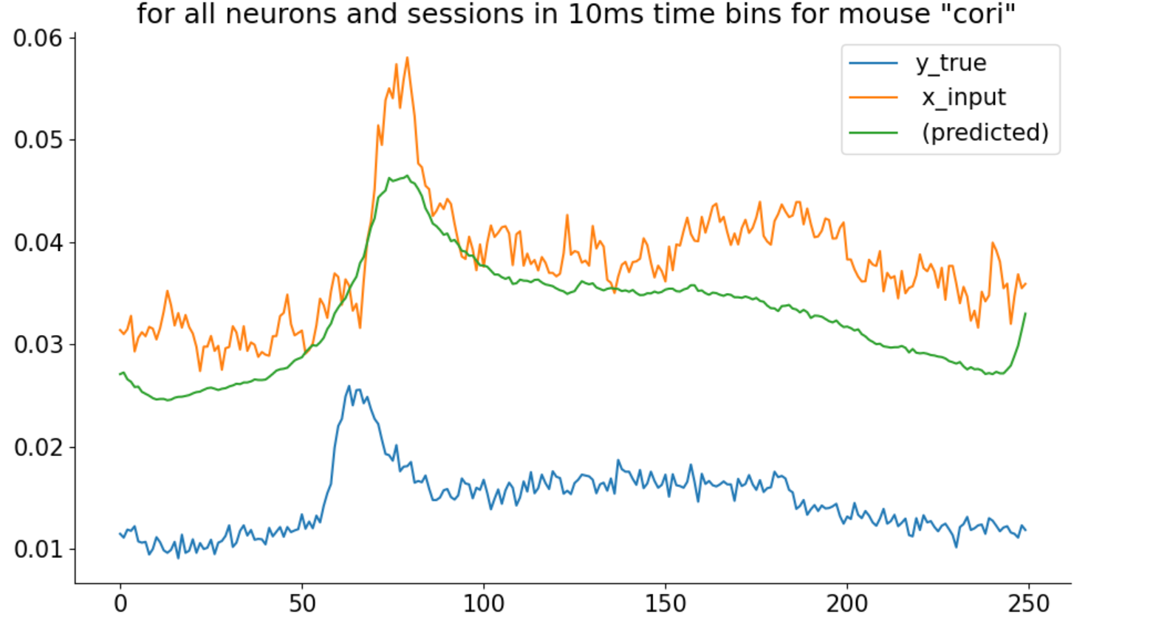
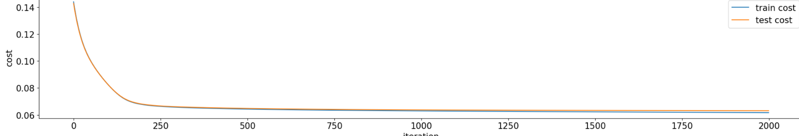
Result
param_grid = {
'ncomp': [10, 15, 20],
'num_layers': [1, 2, 3],
'learning_rate': [0.001, 0.0005, 0.0001],
'activation': ['relu', 'tanh']
x_train, x_test, y_train, y_test = train_test_split(x_input, y_real, test_size=0.2,random_state=seed)

Slide 15
Results
Plot Learning curve
Cross Validation & Grid Search
Find the model cost/error when it is run on test data within a confidence interval
How do we say: That our model has actually been able to predict activity in MOs correctly???

